Slide 1
Graham balls

Slide 2
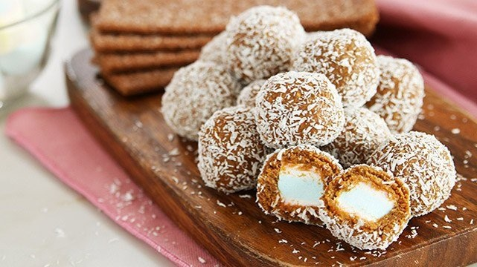
Group 4
Anabel Unida
Claire Raymundo
Ara Guerrero
Desh Buhong
Xyrine Mindanao
Frank Odonez
Airha Homo
Sharmaine Naboye
Renzelle Neri

Slide 3
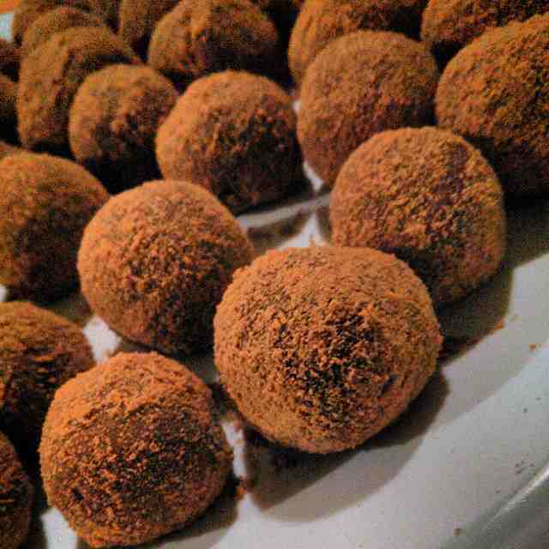
Product description
This project is related to our subject Empowerment Technology as we are asked by our teacher to make our own product and sell them to anyone inside the campus. Our product is “Graham Balls”. This product is made for the taste buds of our customers to satisfy their cravings and their hunger in a cheap price.

Slide 4
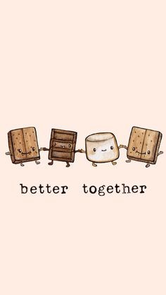
Ingredients/Materials
Ingredients:
Graham biscuits (crushed)
Marshmallows (large size)
Condensed
Procedure:
Coat the marshmallow with condensed
Sprinkle crushed grahams to marshmallows

Slide 5
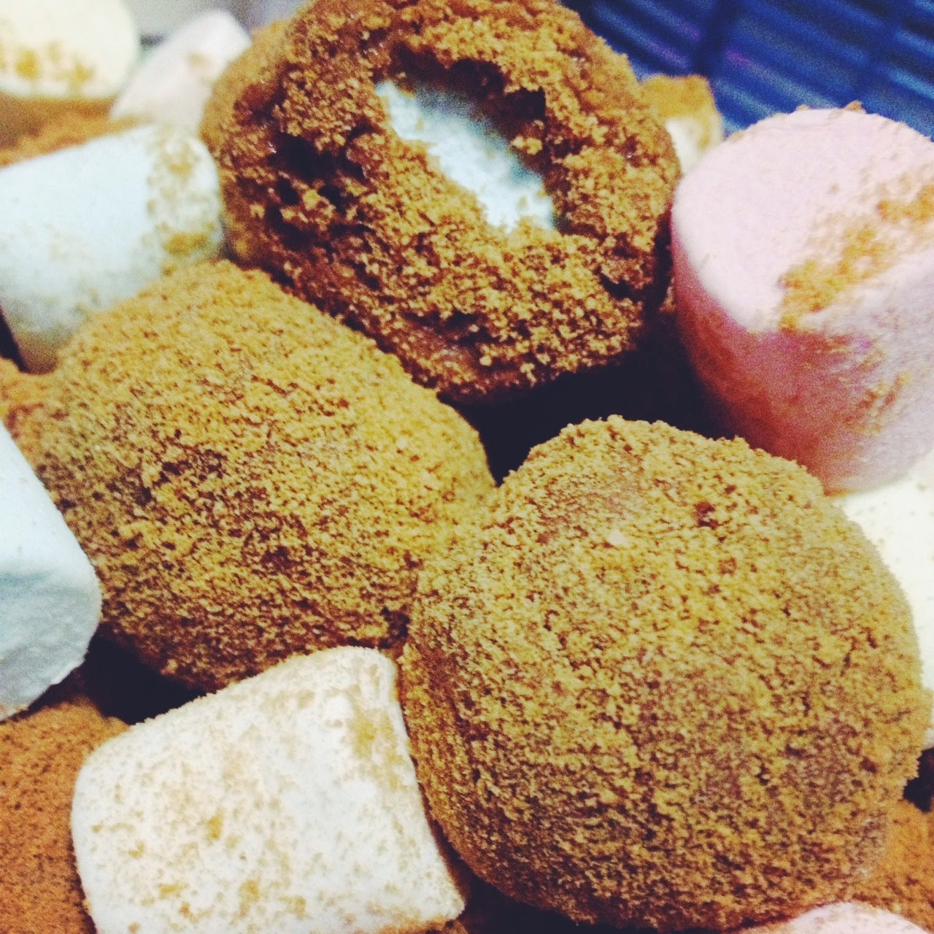
Estimated sale price
Marshmallow – Php. 96.00
Condensed Milk – Php. 36.00
Graham crackers (crushed) – Php. 38.00

Slide 6
PIE GRAPH

Slide 7
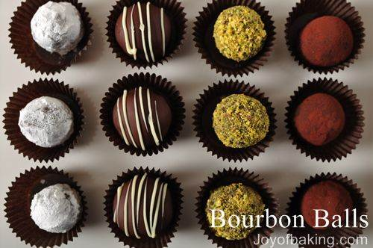
Summary

